Slide 1
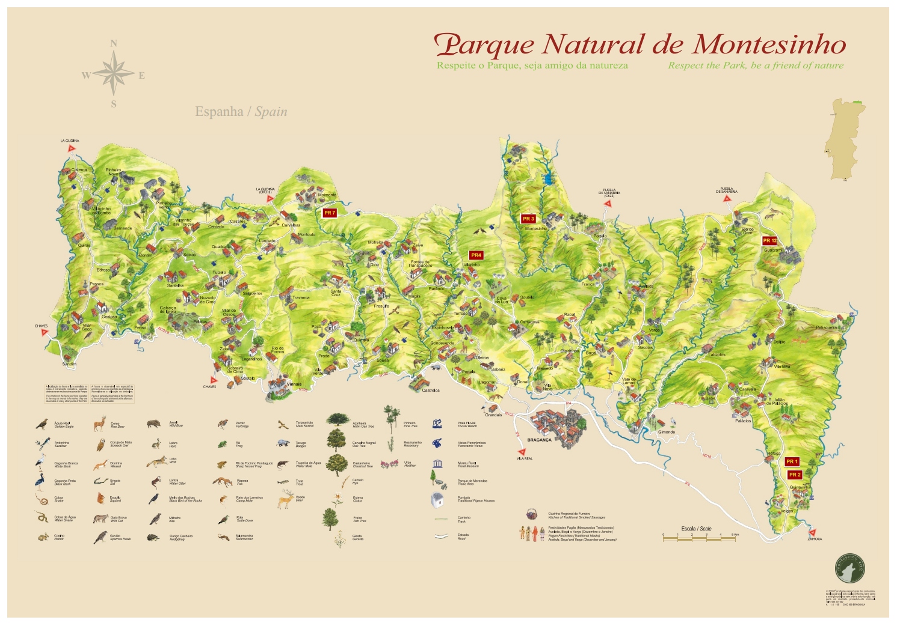
Analysis Of Forest Fire Predictors In Montesinho Natural Park
Consultant: Mier Chen
Client: Kim Jiayu

Slide 2
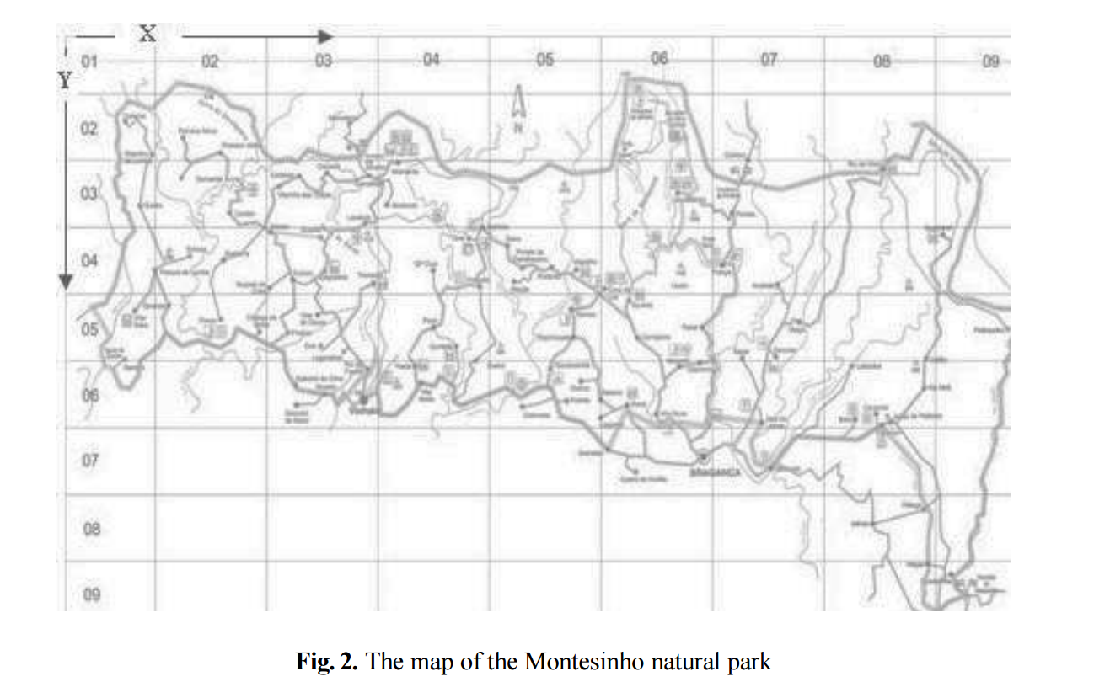
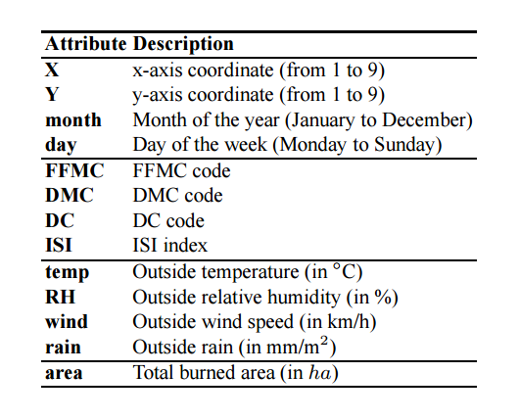
DATA SET: 517*13

Slide 3
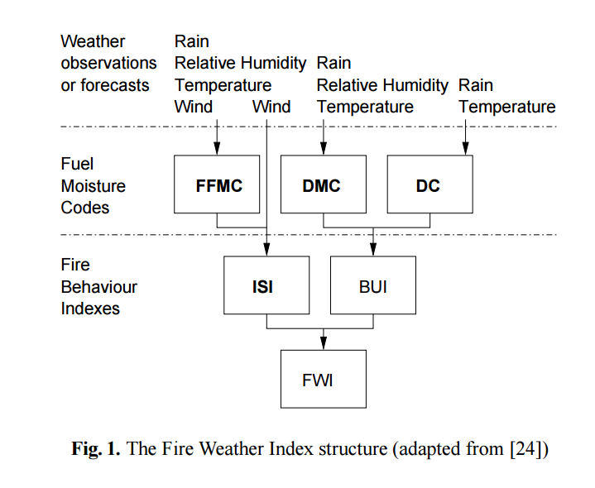
The Forest Fire Weather Index (FWI)

Slide 4
GOAL
Forecast the size of a staring forest fire
Important for firefighters in order to figure out how much manpower and resources should be allocated in each fire

Slide 5
APROACH
１. Exploration
２. Logistic Regression
３. Support Vector Machine
４. Deep Learning

Slide 6
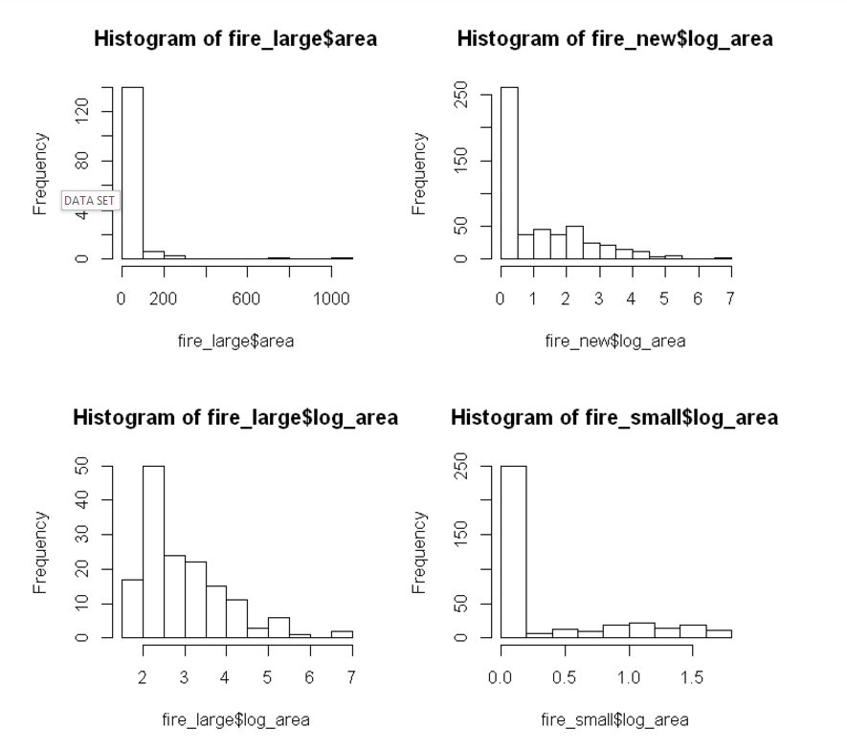
Log(area)
Size:
Small (log_area = 0),
Medium (0 < log_area <= 2),
Large (2 < log_area <= 4),
Super large (log_area > 4)

Slide 7
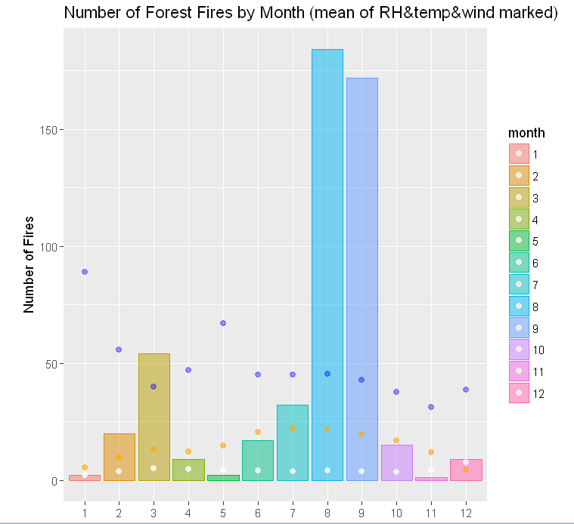
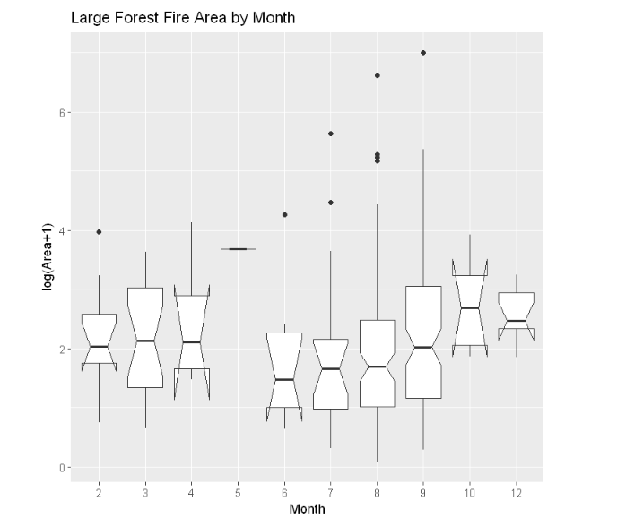
Month
Blue: RH
Orange: Temp
White: Wind

Slide 8
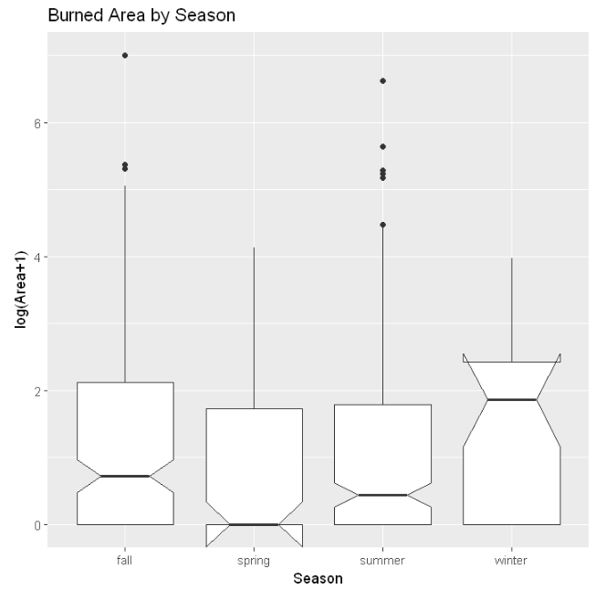
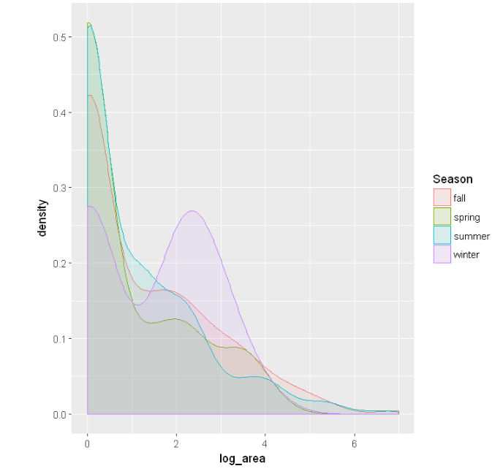
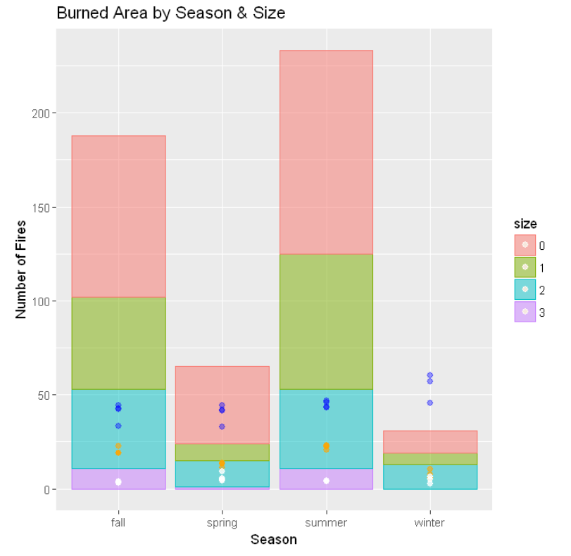
Season
Blue: RH
Orange: Temp
White: Wind

Slide 9
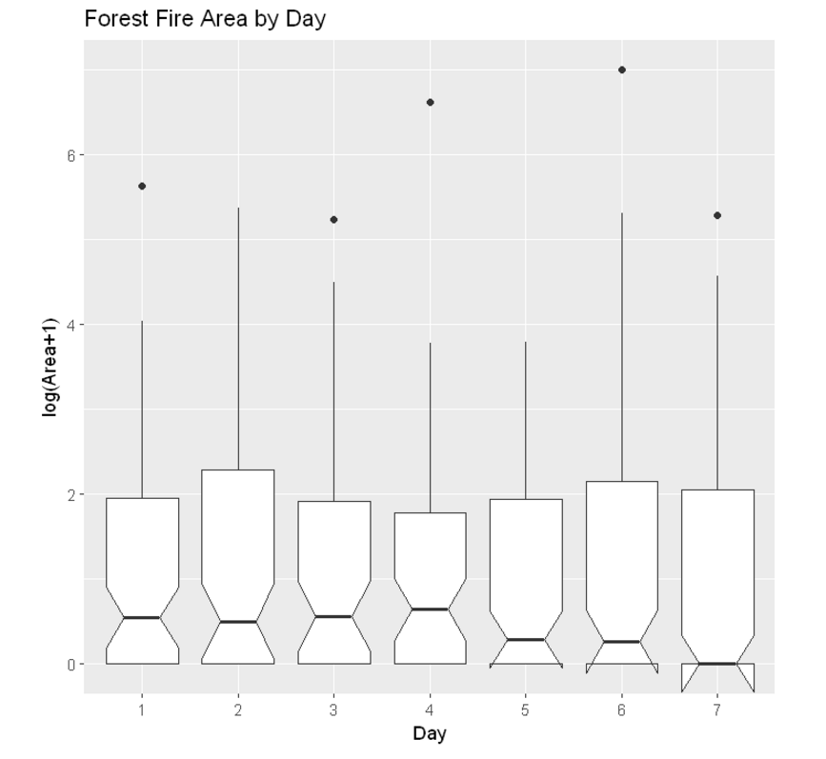
Day

Slide 10
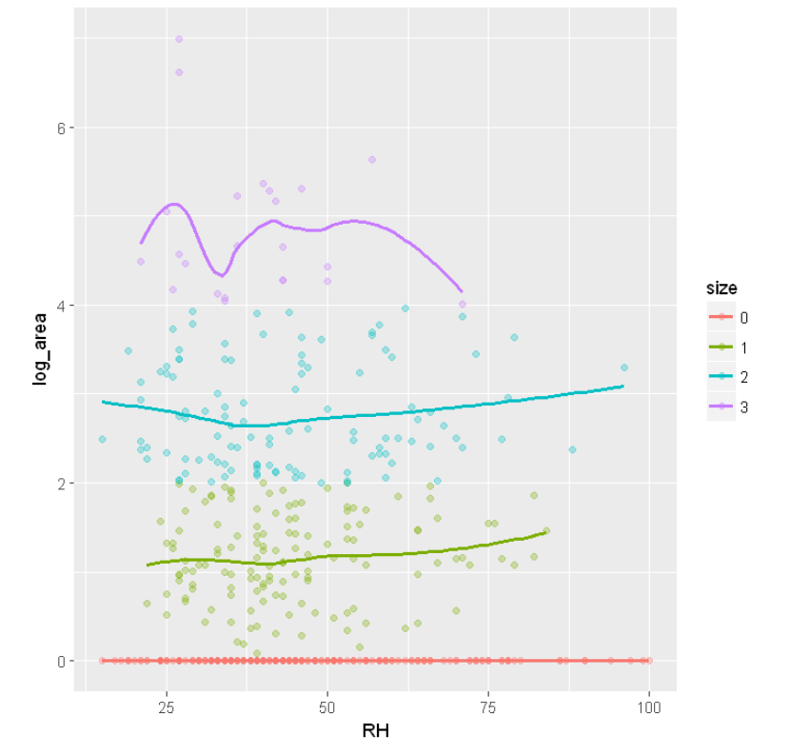
RH
Size:
Small (log_area = 0),
Medium (0 < log_area <= 2),
Large (2 < log_area <= 4),
Super large (log_area > 4)

Slide 11
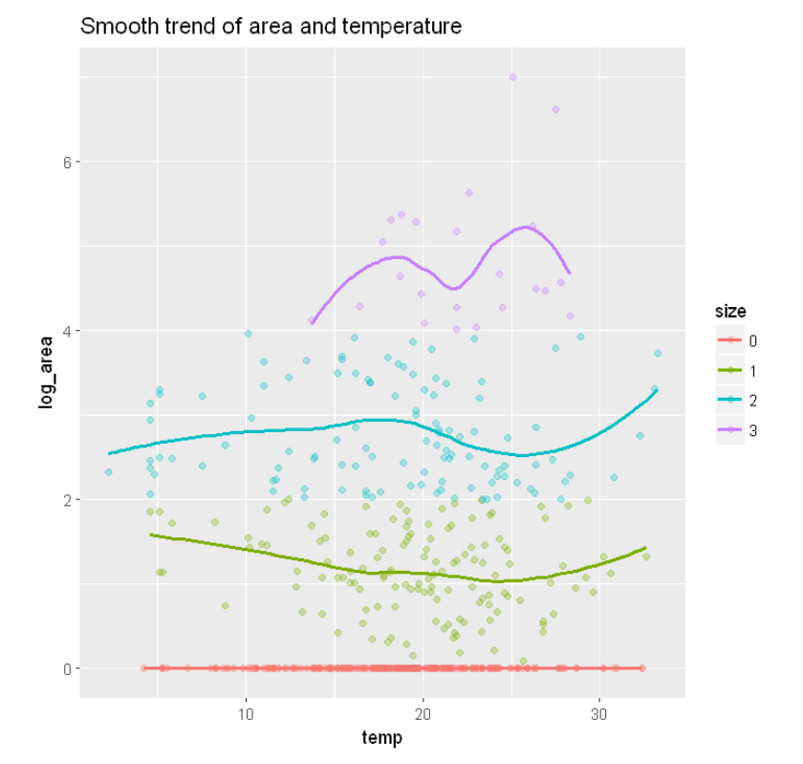
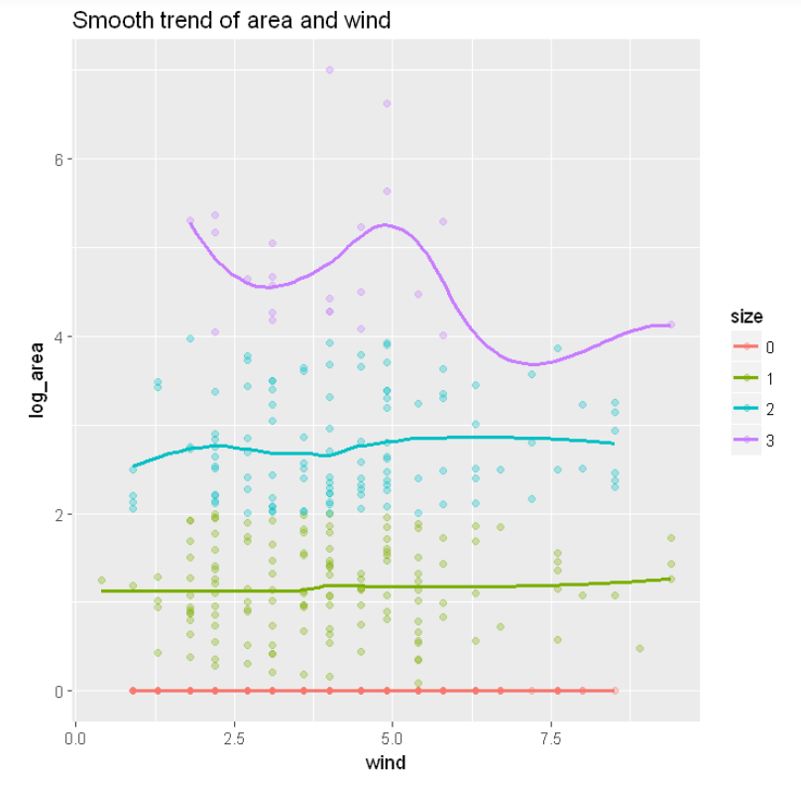
Temp & Wind
Size:
Small (log_area = 0),
Medium (0 < log_area <= 2),
Large (2 < log_area <= 4),
Super large (log_area > 4)

Slide 12
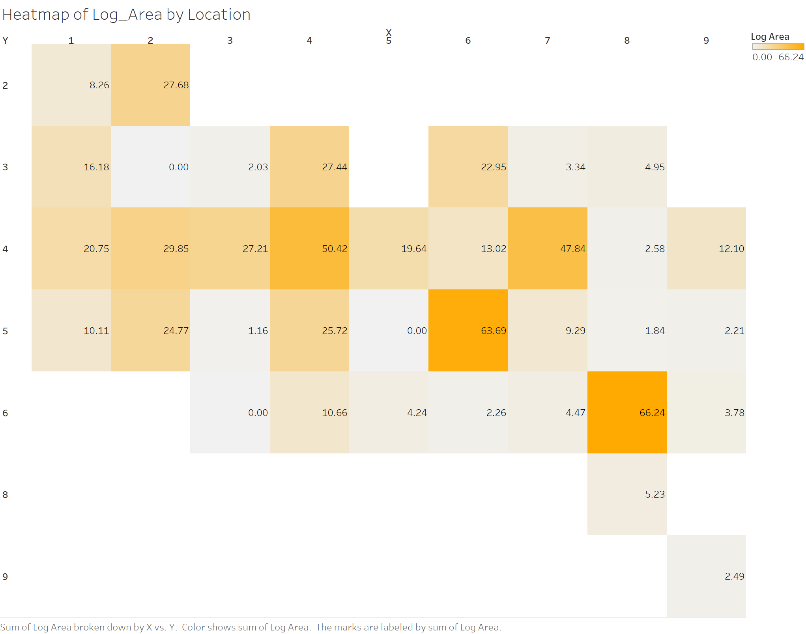
Sum(log_area)
(8, 6)
(6, 5)
(7, 4)
(4, 4)

Slide 13
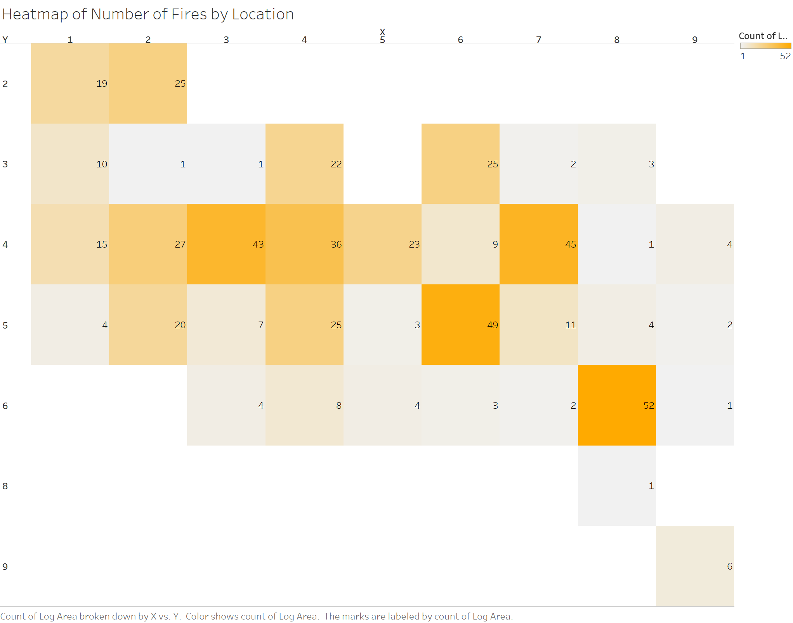
Number of Small Fires
(8, 6)
(6, 5)
(7, 4)
(3, 4)
(4, 4)

Slide 14
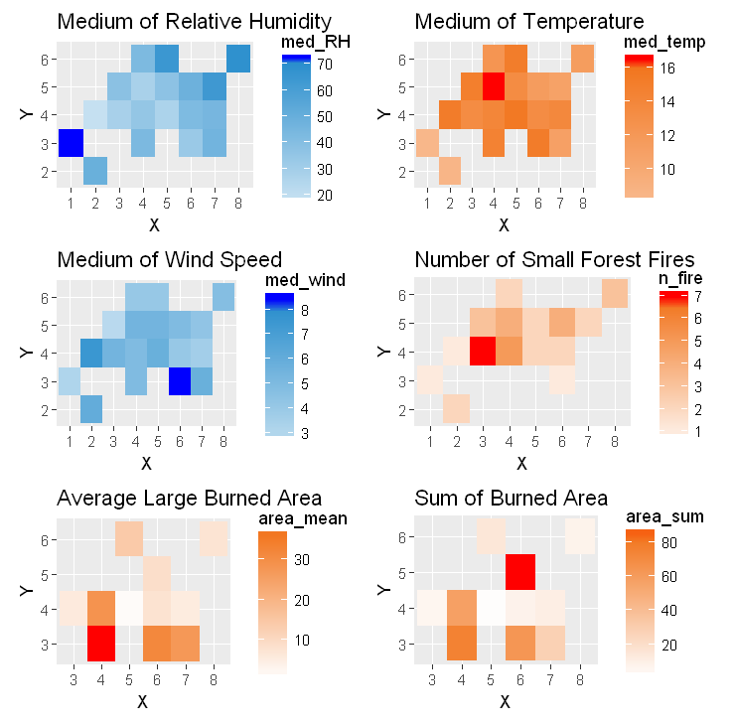
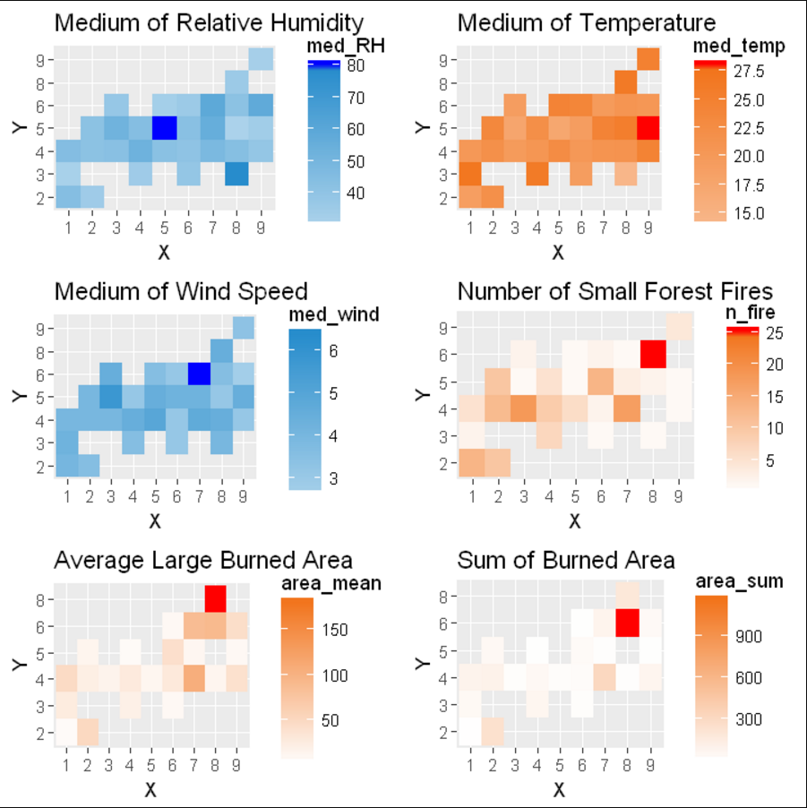
Spring vs. Summer

Slide 15
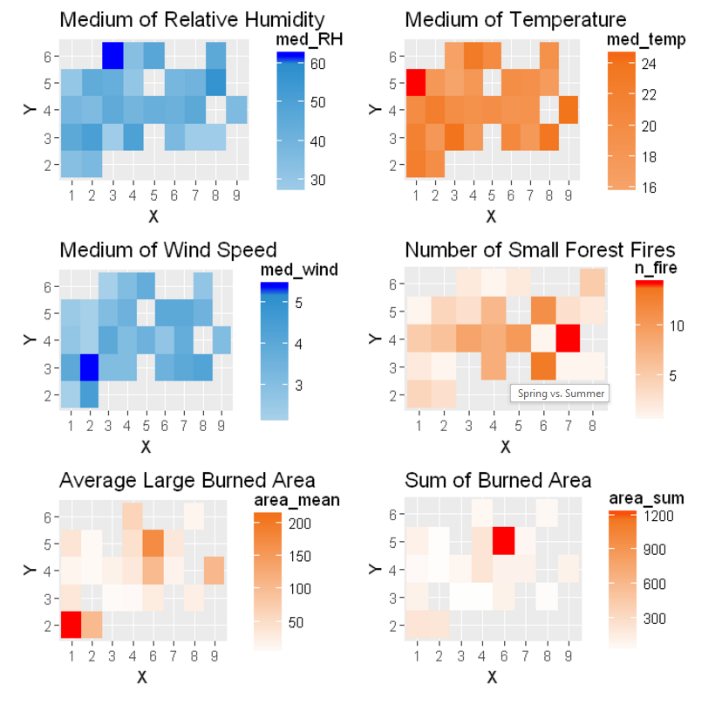
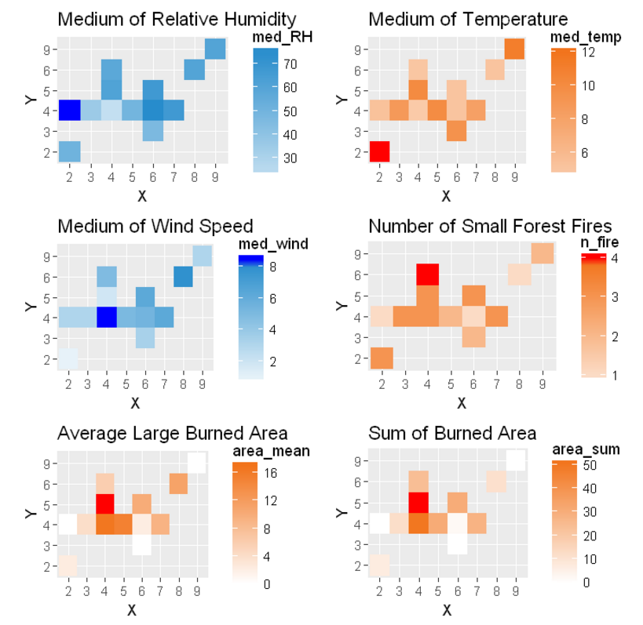
Fall vs. Winter

Slide 16
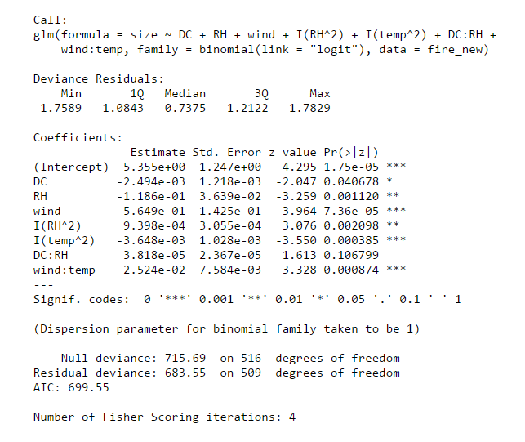
Logistic Regression

Slide 17
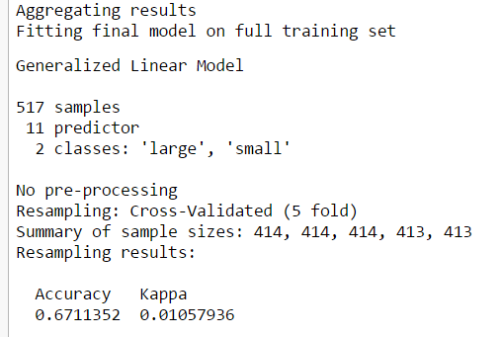
Logistic Regression (10-fold cross validation)
Size:
Small: area < 5
Large: area > 5

Slide 18
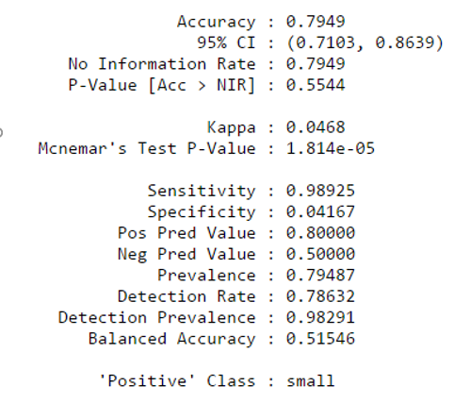
SVM (Gaussian)
Size:
Small: area < 5
Large: area > 5

Slide 19
4 types of Size
Small (log_area = 0),
Medium (0 < log_area <= 2),
Large (2 < log_area <= 4),
Super large (log_area > 4)

Slide 20
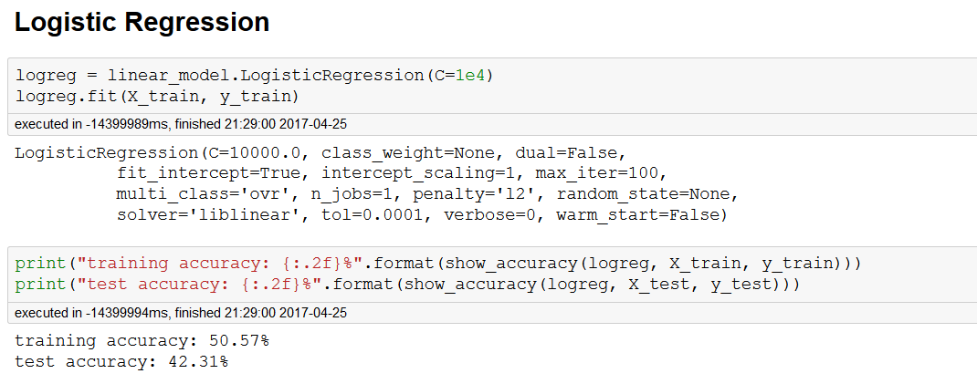
Size:
Small (log_area = 0),
Medium (0 < log_area <= 2),
Large (2 < log_area <= 4),
Super large (log_area > 4)

Slide 21
SVM
Size:
Small (log_area = 0),
Medium (0 < log_area <= 2),
Large (2 < log_area <= 4),
Super large (log_area > 4)
Training: 48.08%
Testing: 41.23%

Slide 22
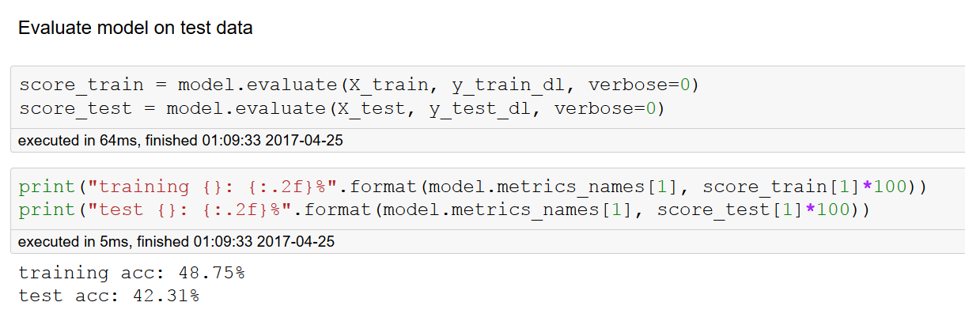
Deep Learning
Size:
Small (log_area = 0),
Medium (0 < log_area <= 2),
Large (2 < log_area <= 4),
Super large (log_area > 4)

Slide 23
Conclusion
Summer and fall
RH < 75
Location: (8, 6), (6, 5), (7, 4), (4, 4)
RH, wind, temp

Slide 24
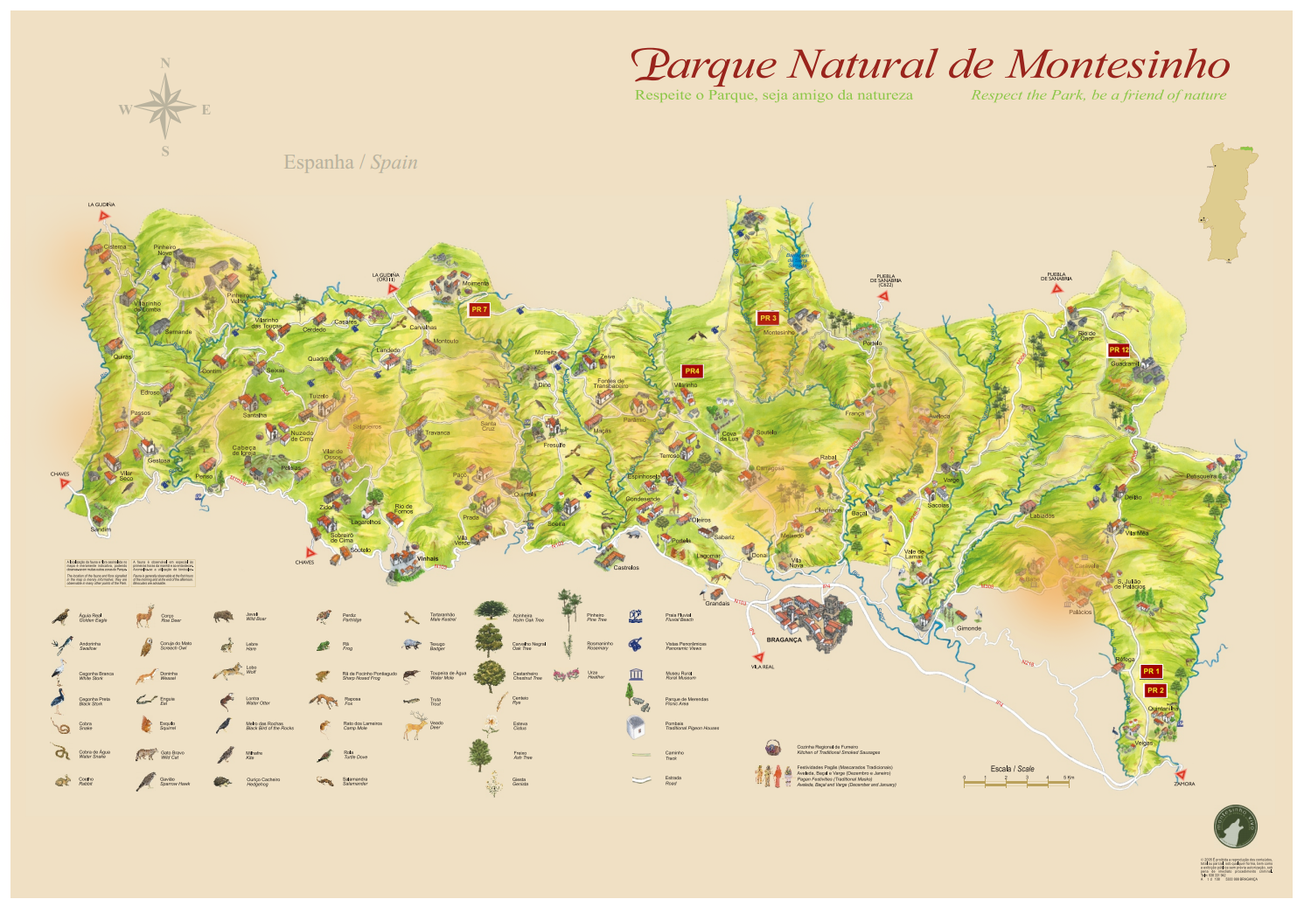
(6, 5)
(8, 6)
http://blog.nycdatascience.com/wp-content/uploads/2016/07/Capture.png
https://www.montesinho.com/files/mapamontesinho.pdf

Slide 25
More variables
Human activities (population, tourism)
Altitude (if the fire is caused by lightning)
Date (time series analysis, check seasonality…)
vegetation coverage

Slide 26
Thank You
Reference
S. Taylor and M. Alexander. Science, technology, and human factors in fire danger rating:
the Canadian experience. International Journal of Wildland Fire, 15:121–135, 2006.
Natural Resources Canada, (2008, July 11). Canadian Wildland Fire Information System. http://cwfis.cfs.nrcan.gc.ca/background/summary/fwi.
Natureza, T. d. (2014). montesinho.com - Nature Tourism. Retrieved from https://www.montesinho.com/en/oparque/mapa

